Slide 1
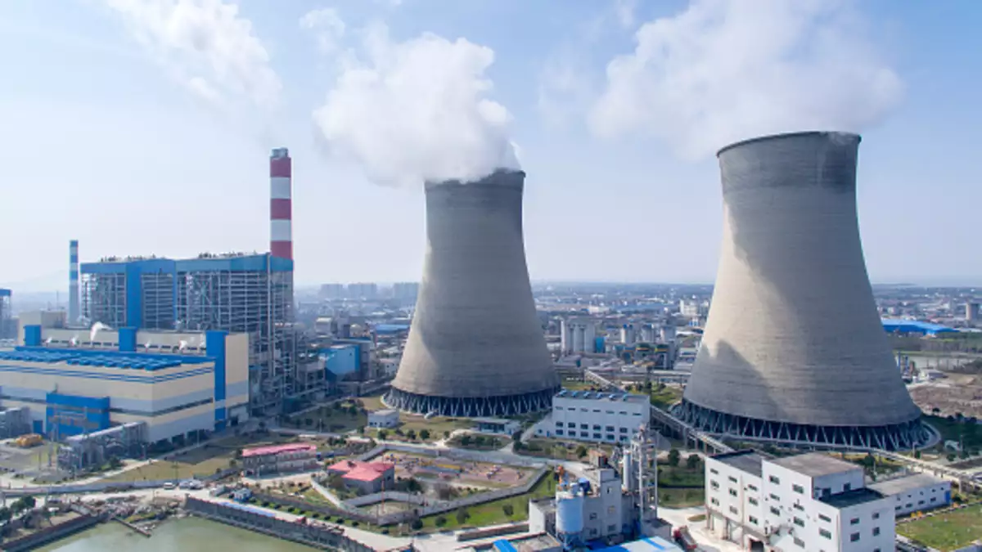
Power Plant : Thermal efficiency improvement

Slide 2



Under the mentorship of: Ankur Bhattacharjee , Praveen Vijayvargiya
Presented By:
Mudit Srivastava
Siddhartha Jejurkar
2018A3PS0430G
2018A3PS0617G

Slide 3

CONTENTS
MidSem Overview
Automated Process Control (APC)
Types of Control Systems
Applications, Advantages and Disadvantages
Auxiliary Power Consumption
Effect of Power Consumption
Plant Load Factor
Reducing Auxiliary Power Consumption
Latest technologies in TPP
Project Overview
References

Slide 4
MidSem Overview
In Thermal power plants, the heat energy obtained from combustion of solid fuel (mostly coal) is used to convert water into steam, this steam is at high pressure and temperature.
This steam is used to rotate the turbine blade while turbine shaft is connected to the generator. The generator converts the kinetic energy into electrical energy
A thermodynamic cycle is a series of operations, involving a heat source, a heat receiver, a machine and working substance.
Rankine cycle is the theoretical vapor-liquid cycle on which steam power plant works

Slide 5
Rankine Cycle is modified into two types of cycles:
Reheat Cycle
Regenerative Cycle
Major factors affecting overall efficiency of power plants :
Boiler efficiency
Cycle efficiency
Turbine efficiency
Generator efficiency
The overall efficiency of thermal power plants is quite low, generally about 40%.

Slide 6
What is Automated Process Control?
Use of machines and equipment for performing physical and mental operations in a production process in place of human being
Automation has been used since the time of ancient Egypt and Greece from more than 2000 years ago.
It can be done at various levels of manufacturing system
Handling raw materials, semi finished goods or finished goods
During production processes
In Inspection and Quality control operations

Slide 7
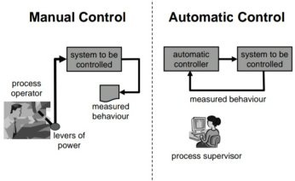
Glimpse of difference between Manual and Automatic Control

Slide 8
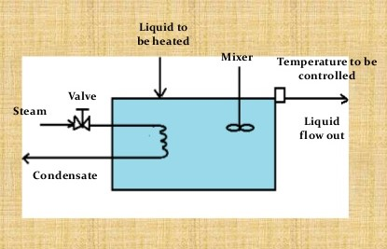
Simple heat exchange process in an Open loop system

Slide 9
Types of Control Systems we can implement in this process
Open loop system
Closed loop feedback system
Manually Controlled
Automatically Controlled

Slide 10
In Manually controlled system an operator periodically measures the temperature of liquid. If for example, the temperature is below the desired value, he increases the steam flow by opening the valve slightly
For Automatically controlled system a temperature sensitive device is used to produce a signal proportional to the measured value. This signal is feed to controller which compares it with the present desired value. If difference exists, the controller changes the opening of the steam control valve to correct the temperature

Slide 11
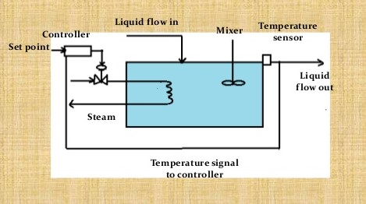
Automatic feedback controlled system

Slide 12
Few similar applications in Thermal Power Plants
Automatic control of feed water to boiler
Steam turbine control
Actuator non linearities
Affects of boiler in the transient stability field
Advantages of this Automated Process Control
Effective control on operation
Greater accuracy, more output and speed
Minimization of wastage
The production planning and control to be done in the beginning only

Slide 13
There are few Disadvantages too
Huge capital investment is required
Maintenance cost is very high
Continuous power supply is required
Large inventories are required

Slide 14
Auxiliary Power Consumption
Auxiliary power accounts for the power consumed by plant equipment and its auxiliaries.
Out of the total power generated by a Thermal Power Plant, nearly 8 to 10% of it is consumed by the plant equipment and machinery required to keep the plant operational.
Major equipment consuming auxiliary power :
Boiler feed pump
ID fans
PA fans
SA fans
Pulverizers
Electrostatics precipitators,etc

Slide 15
Effect on power consumption due to changes in plant conditions
Auxiliary power consumption doesn’t just contribute to overall efficiency parameters, but an overtime change measured as % of total power generated can indicate degrading machine cycles or faults in the pipeline due to increasing age of the equipment.
Air leakage into boiler gas enclosure.
Degraded Boiler heating Surface –higher dry gas loss would increase power consumption
Higher draft loss due to air ingress and ash deposition.
Deterioration of generator stator windings due to increased stress and age
Deterioration of Turbine Steam Path Condition.

Slide 16
Condenser pressure/ condenser cleanliness- air ingress and extent of tube pluggage. Contamination of feed water can cause changes in heat capacity, that indirectly affects boiler efficiency
Steam and water leaks from drains and vents.

Slide 17


Plant Load factor
The auxiliary power is greatly influenced by the plant load factor. Many of the Indian power stations are operating at sub-optimal plant load factor that cause higher auxiliary power and decreased efficiency and performance.
Plant Load Factor (PLF) can be used as a measure to quantify the auxiliary power consumption.
Instantaneous plant load factor is given by :
Whereas the auxiliary power consumption of individual equipment is given by :

Slide 18
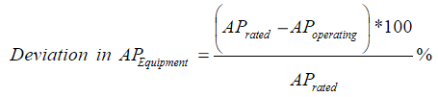
Since auxiliary power of equipments have a baseline which is the set design value, it is actually the deviation which acts as a control parameter to optimize the the auxiliary power consumption. The formula for the deviation in AP of individual equipment is given by :
Measures to improve plant load factor include:
Quality of coal used - higher calorific value and low ash content coal reduces the flue gas flow, which decreases stress on ID fans.
Boiler efficiency - increased boiler efficiency reduces stress on BFP, PA fans and SA fans.
Turbine efficiency - increasing turbine efficiency ensures reduced stress on CWF pumps and alternator windings.

Slide 19
Reducing auxiliary power consumption
Consider Variable frequency drives for Boiler feed pumps, fans and other major Auxiliaries.
Choose optimum margins on head and flow for Boiler feed pumps and fans, to attain best efficiency under actual operating conditions.
Design Boiler with best possible thermal efficiency
Leak proof duct design to avoid air ingress in order to reduce load on induced draft fan.
Ensure complete combustion in furnace, so that required steam generation can be achieved with optimum fuel quantity.
Minimise system drop (flue gas side , steam and water side) without affecting the Boiler performance

Slide 20
Latest Technology in TPP
Thermal power plants contribute the highest level of emissions among the power generation sources, causing air quality and other environmental concerns.
Thermal Power is the main source of electricity generation in India. It stands at 230.6 GW out of which 198.5 is from coal alone
New standards in TPP
Overcome these issues

Slide 21
Some of the latest technologies around the world that are being implemented are:
AdvX™ Heat Recovery Technology
recover and utilize additional heat from flue gas
AdvX™ Stack Gas Reheat
AdvX™ Upgrade solutions
Ultra super critical (USC) conditioning
Conventional thermal power plants
Hirono No. 5 Thermal Power Station of Tokyo Electric Power Company
Most sophisticated coal-fired TPP

Slide 22
Digitalization Technology
Continuous combustion tuning with artificial intelligence
Turbine operational optimization in real time using a combination of first principle analytics and machine learning
Predictive maintenance to avoid unplanned downtime using machine learning
Reducing stresses during variation on load to avoid failures and reduce maintenance needs
Remote monitoring for visibility and analysis
Oxyfuels

Slide 23
Project overview
Based on the study of Thermal Power plants, Advanced Process Control (APC) and Auxiliary Power Consumption, following observations and conclusions of the Vikram Cement Works Power Plant have been made :
No control loop exists for coordinating boiler and turbine operations. An APC on top of existing control loops can help improve performance and efficiency
There is no continuous performance monitoring of the plant. A performance monitoring and reporting system can help in fine tuning of machinery and equipment during operation.
Installation of Variable Frequency Drive can reduce Auxiliary Power Consumption of various motors and pumps used in the plant.
Advanced controller for furnace pressure control can help in reducing auxiliary power consumption of PA and SA fans.

Slide 24
5. Advanced Controller for fuel feed can improve and provide stable response to air and fuel feed. This model can tune fuel feed parameters so that the combustion cycle adjusts to any changes in fuel type/composition.

Slide 25
Thank you

